Slide 1


OkCupid's Pathways to Matchmaking Success
Team Members:
Adarsh Prajapat
Jasmine Gohil
Gunjan Sharma
Parita Patel

Slide 2

INTRODUCTION
Launched in 2004, it was one of the first major dating platforms to emphasize Inclusivity & Diversity
OkCupid uses a Question-Based Matchmaking approach to find potential matches by asking users a wide range of questions on various topics.
It’s standout features is its match percentage algorithm, which calculates compatibility based on users' answers to questions.
Objective 1
Identify underlying clusters of users.
Objective 2
Understand the dimensions of compatibility.
Objective 3
Ultimately, enhance the matchmaking process.

Slide 3
DATASET OVERVIEW
Data Source:
Extracted from the paper "OkCupid Data for Introductory Statistics and
Data Science Courses"
Size and Scope:
Feature profile information from 59,946 OkCupid users in San Francisco as of June 2015
Data Features:
Contains 31 attributes per profile - demographics, lifestyle choices, and responses to 10 essay questions
Data Quality:
Missing values + Prefer not to say
Mapping of the columns

Slide 4
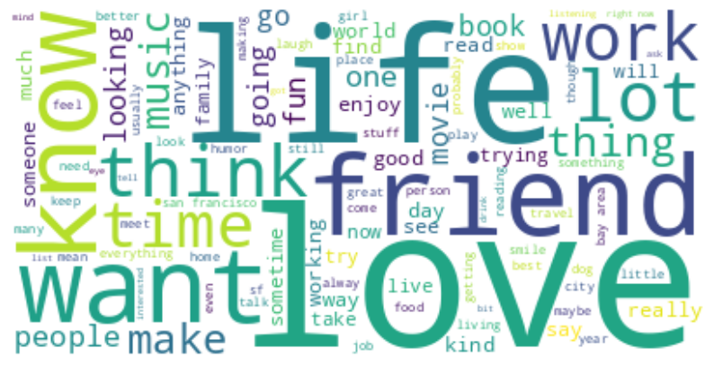
WORD CLOUD
The frequency of word usage within our dataset is depicted by the size of the word, offering an immediate perception of the most prominent terms.

Slide 5
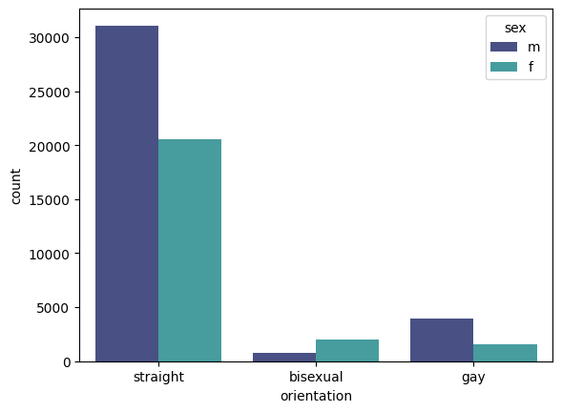
DISTRIBUTION OF GENDERS ACROSS DIFFERENT ORIENTATIONS
We observe a significant representation of male and female users across orientations, with notable diversity in non-binary identifications.
A substantial number of users identifying as female show a preference for bisexual orientation, whereas male users predominantly identify as straight.

Slide 6
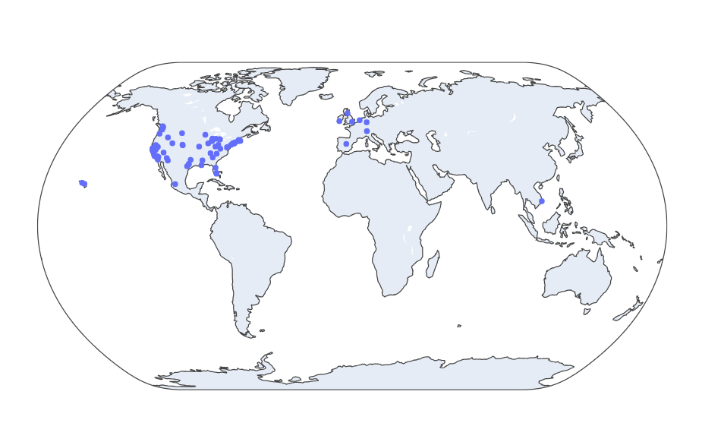
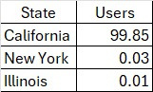
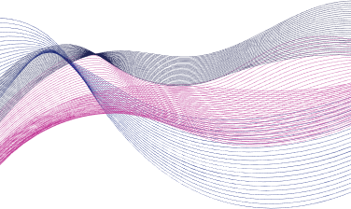
USERS ACROSS THE GLOBE
The bulk of our user base is situated in North America, with the distribution across states as follows:

Slide 7

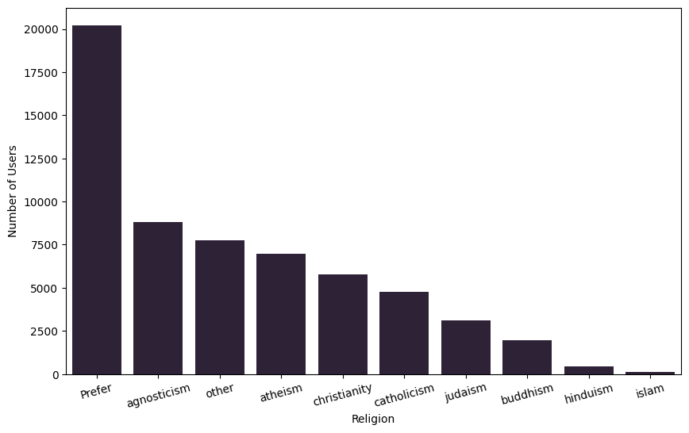
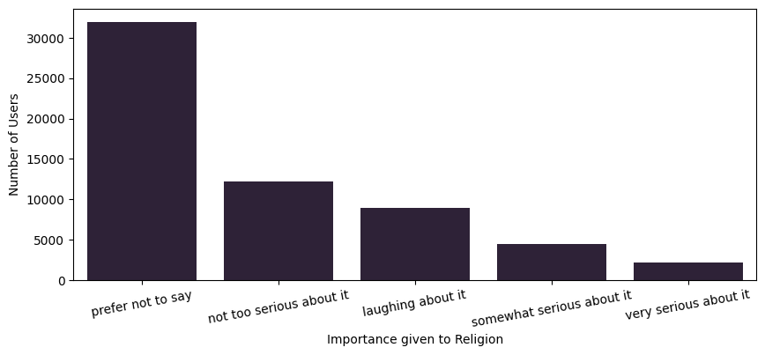
RELIGION BASED ANALYSIS
Most people do not want to disclose their religion on their profile.
The majority of users who disclosed their religion identify as agnostic, while Islam has the lowest representation among disclosed religions.
Majority are not deeply invested in their religious beliefs, while a small minority exhibit strong religious commitment.

Slide 8





PROFILING
DATA SUBSETTING
TEXT
ANALYSIS
CLUSTERING

Slide 9
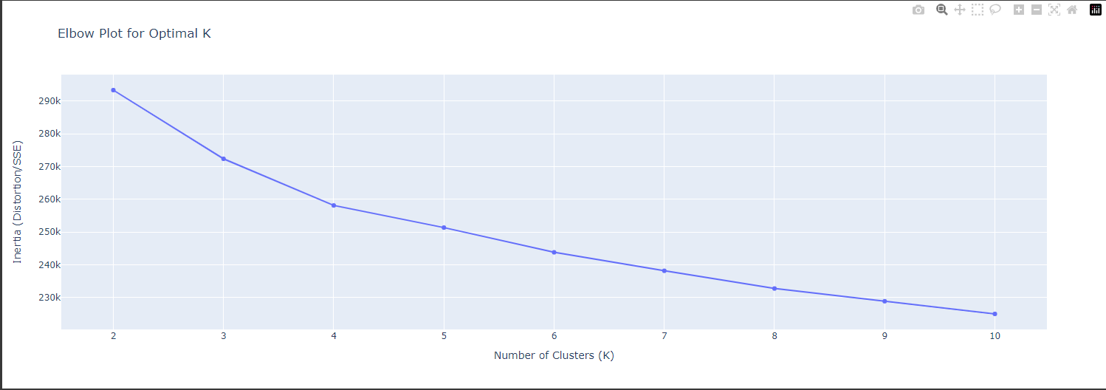
CLUSTERING - KMEANS
Optimal K = 6

Slide 10
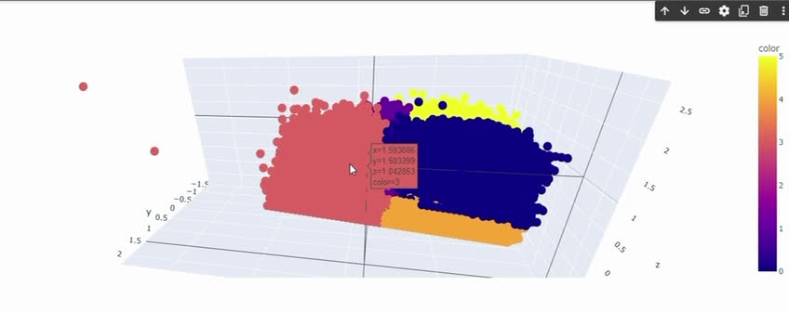
CLUSTER VISUALISATION

Slide 11
PROFILING
DATA SUBSETTING
TEXT
ANALYSIS
CLUSTERING

Slide 12

Profile : 476
Cluster : 1
Orientation : Gay
Sex : ‘m’

Slide 13

TFIDF
max_features = 5000
Profile : 476
Profile : 39245
christmas story citizen kane a clockwork orange doctor zhivago dogma donnie darko double indemnity dr strangelove drugstore cowboy ed wood fargo fight club a fish called wanda the godfather i and ii please heathers hero hiroshima mon amour hoop dreams kiss kiss bang bang la confidential lawrence of arabia legend of drunken master lost in translation m the maltese falcon memento monty python all of them north by northwest o brother where art thou office space
illusion la confidential fear and loathing in las vegas the right stuff the amazing adventures of kavalier and clay zeitoun slaughterhouse five movies the godfather pt i and ii not pt iii blade runner its a wonderful life jaws blue velvet brazil the incredibles toy story high fidelity donnie darko safety not guaranteed star wars alien prometheus the avengers cabin in the woods goodfellas a clockwork orange rushmore fargo the big lebowski the dark knight inception fight club
Similarity = 0.21
Notes:
max features - chat language - spell mistakes - tried spell checker package - did not run - huge dataset - max features removes less frequently occurring words

Slide 14
WORD2VEC
(vector_size = 100, window = 5, min_count = 5, workers = 4)
Profile : 476
Profile : 34952
im a swm born and raised in new orleans living in san francisco i graduated from sfsu with a degree in film production and im a ......watching a movie drinking a beer and relaxing that im not willing to admit it here you like funny sweet and nerdy guys and you think we would be a good match
feeding people i know my way around the kitchen trivial pursuit especially pop culture editions ive amassed a ..... i want to traveling i want to goeverywhere my next meal probably something mellower than ill do saturday night dinner out with friends live music movie cook dinner
Summary:
Skilled in cooking, enjoys pop culture trivia, and adept at diffusing tension with humor. Loves exploring San Francisco and shares positive energy with others.
Summary:
Bookworm with a love for music, especially from the '80s. Enjoys a wide range of TV shows and movies. Values humor, music, and staying active, with a strong desire to travel and experience different cuisines.
Similarity = 0.99
Notes:
max features - chat language - spell mistakes - tried spell checker package - did not run - huge dataset - max features removes less frequently occurring words

Slide 15
CONCLUSION
Utilize algorithm for refined and accurate matching experience.
Analyze user-generated text data.
Apply machine learning algorithms for better understanding of preferences, personalities, and compatibility factors.
Increase matching accuracy for higher success rates.
Enhance platform reputation and attract larger user base.

Slide 16
BUSINESS APLICATIONS
Online Dating Platforms
Social Networking Services
E-commerce Platforms
Content Streaming Services
Human Resources Technology
Health and Wellness Apps

Slide 17
CHALLENGES
Huge dataset - mapping for categorical columns
tSNE failed due to high computational time
High dimensional data, was difficult to analyze the cluster patterns
Informal language with lots of spelling mistakes
Could not run Spell Checker iterations

